Slide 1

Around
The
Digital
World
In
90 mins

Slide 2
About Me:

Slide 3
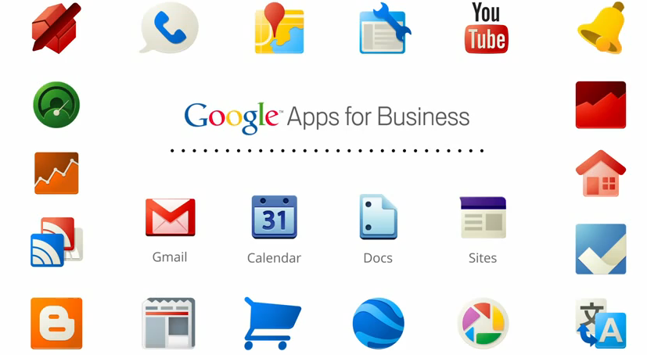
Courtesy: http://whitehatsme.com/wp-content/uploads/2014/03/Benefits-of-Google-Apps.png

Slide 4
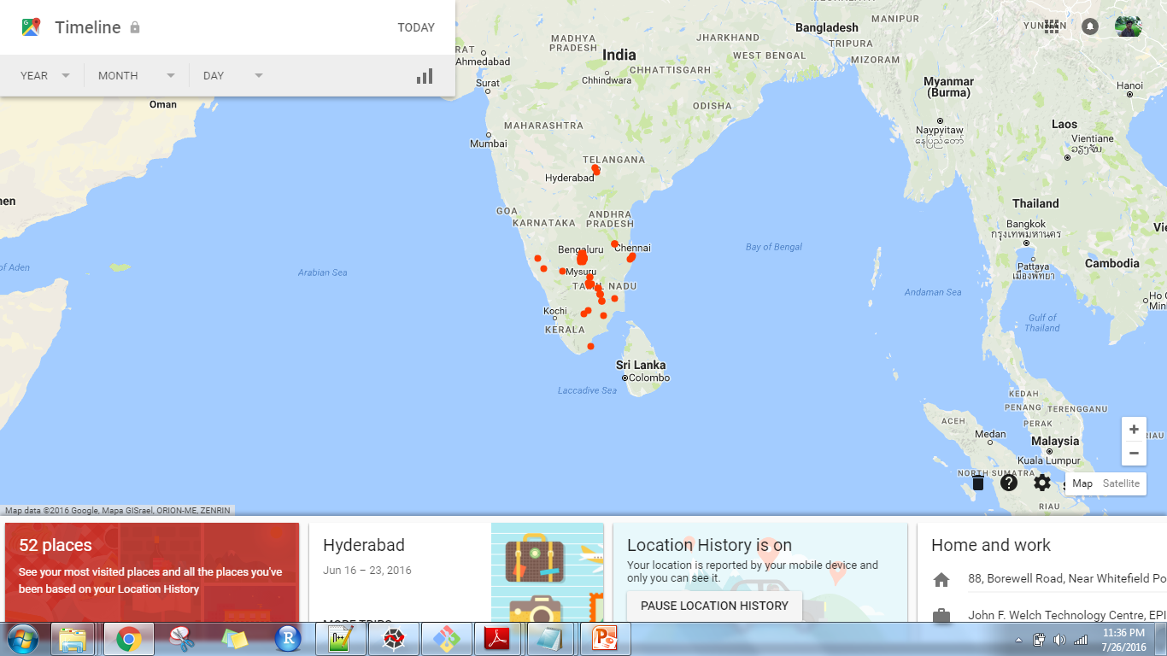
https://www.google.com/maps/timeline?authuser=2

Slide 5
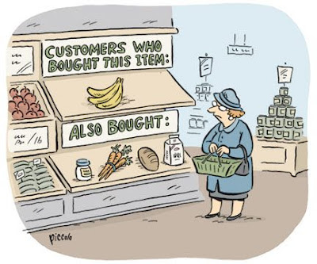
They know what you want before you do…
Turbines which experienced this:
Also Experienced
These:

Slide 6
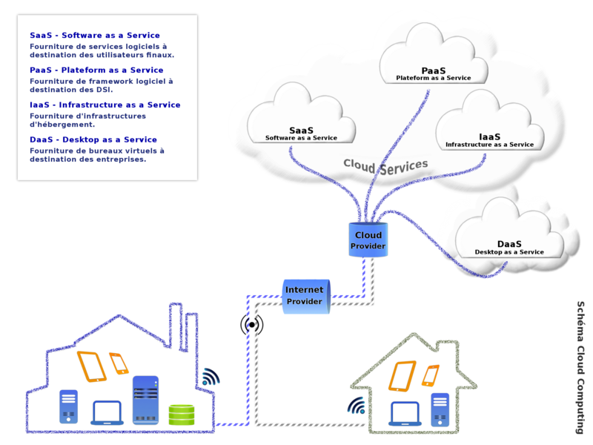
Enablers:
Higher connectivity
Cheaper storage
Increased processing capability

Slide 7
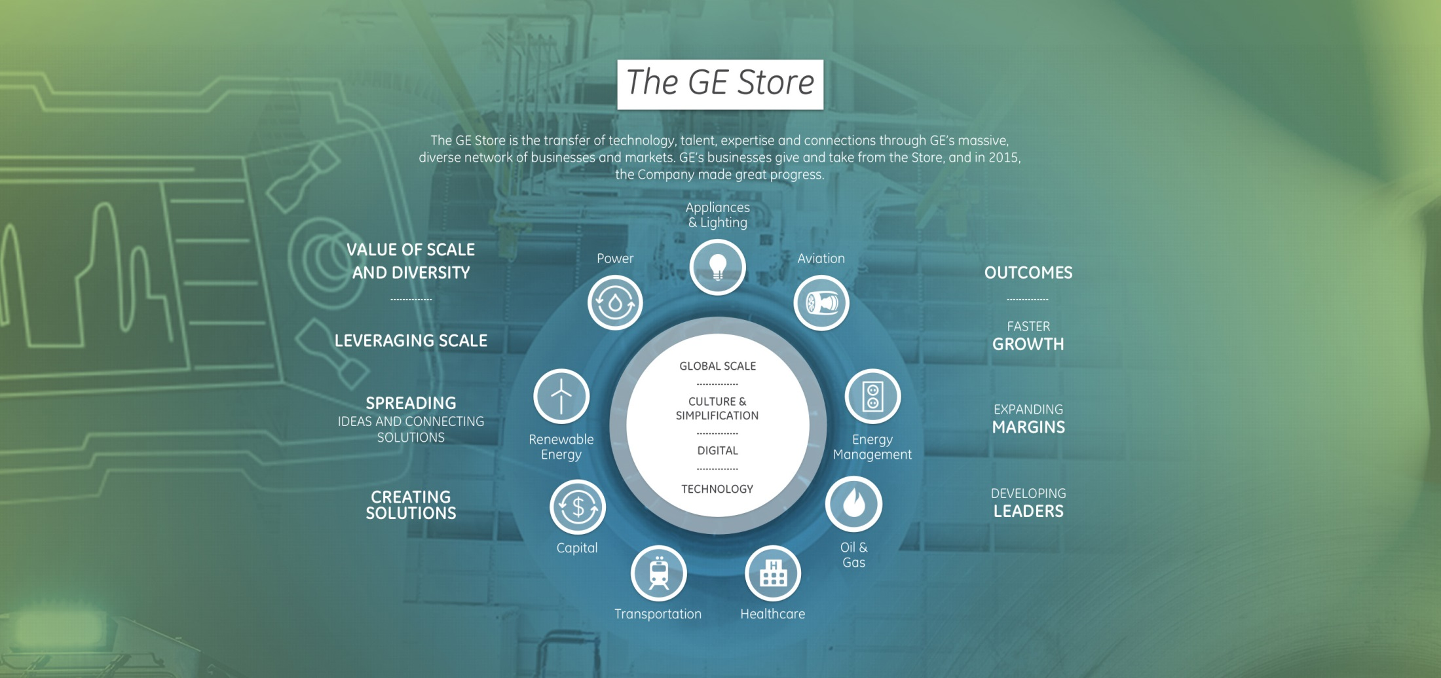
GE Digital…

Slide 8
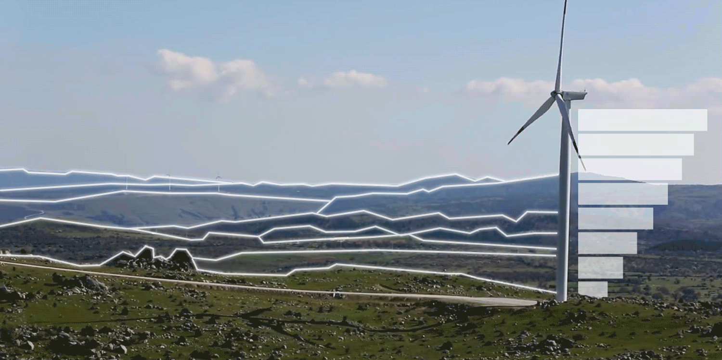
Digital Wind Farm

Slide 9
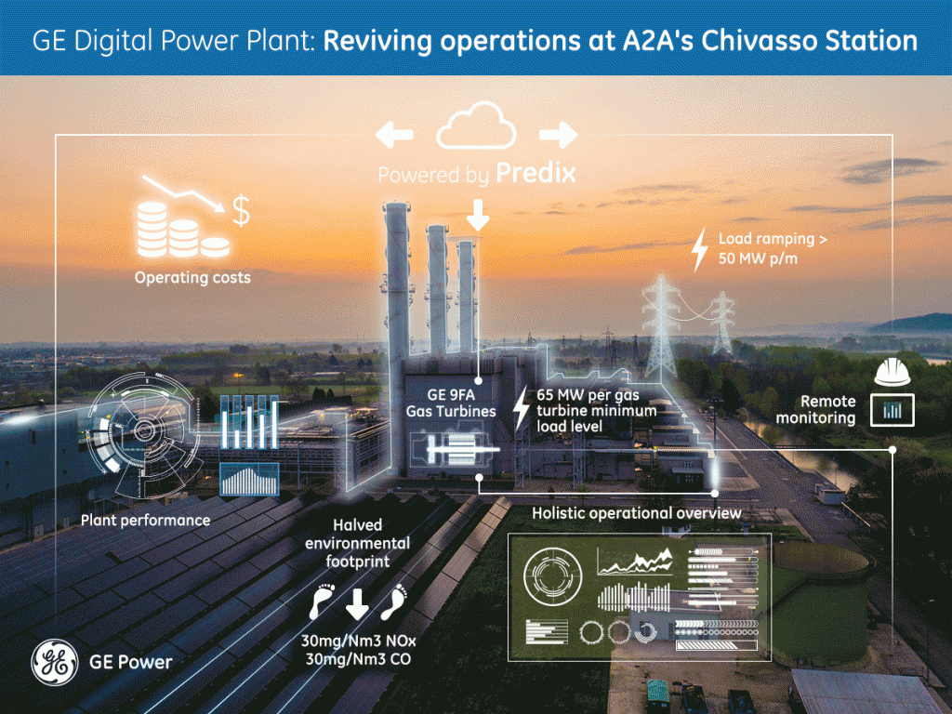
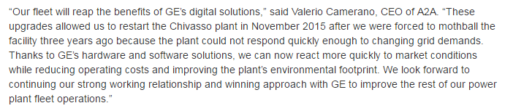

Slide 10
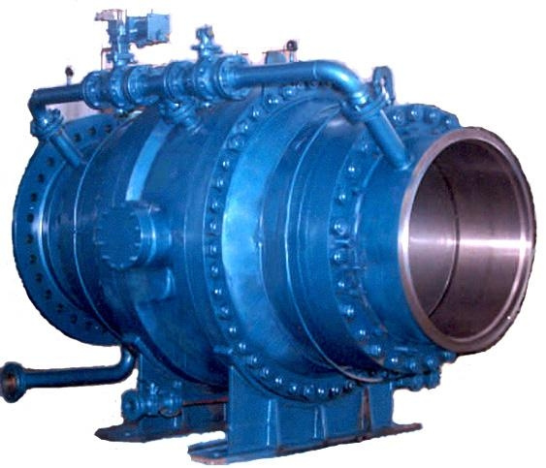
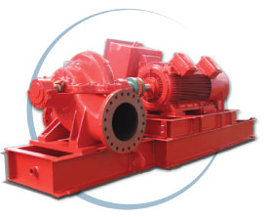
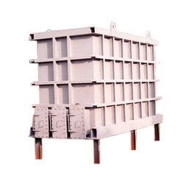
Data Science & Domain Analytics
1
Data dictionary
2
Analytics catalog
3
Analytics content
# of plant failure modes
PDS Catalog
Business optimization
Market intelligence & Forecasting
Portfolio optimization
CCAP /M&D Refactored
GT Water Wash
GT Wheel Space
….
Combustion Gas Leakage
Existing
Operations Optimization
Operations Evaluation
Plant / Fleet Optimization
Outage Management
APM/OO Scrum
Asset Performance
Machine & Equipment Health
Reliability Management
Maintenance Optimization
Digital Twin models
Q1 - MVP
Q2 - Diversify
Q3 - Launch
Q4 - Scale
Key actions
Id gaps/dependencies
Prioritize target analytics
Refactor & add - PS
Add additional PS + GRC analytics
Harden catalog
Finalize data dictionary
Add additional fuel types
Build usage workflow
Drive adoption
Customer validation
60% of all Power analytics in catalog
Expand to value chain
Platform
# of analytics
Predix
30
Predix
60
Predix
90
Predix
100⁺

Slide 11
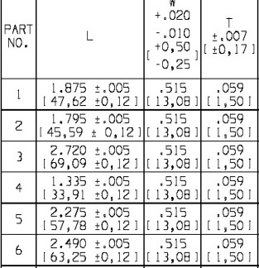
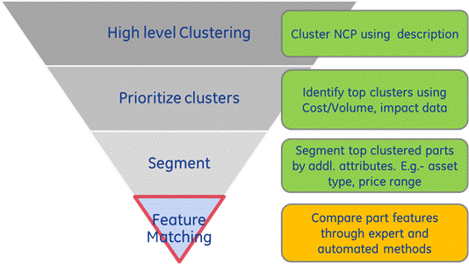
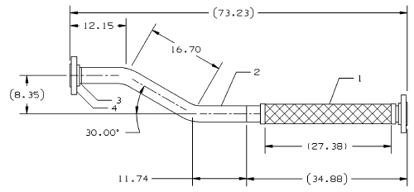
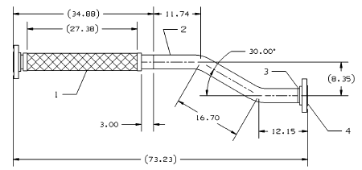
Data Sciences for Productivity Apply data science methods to CSA backlog opportunities
~500 CSA Contracts; ~$10B backlog
Focus on Parts & Outages
Cost & Variation
Non-capital parts
Parts Harmonization
Unscheduled /Unplanned Outage
Optical Pattern Recognition on Drawings to identify similar parts
$40 MM CSA productivity in 2016

Slide 12
Hands On

Slide 13
Python Basics

Slide 14
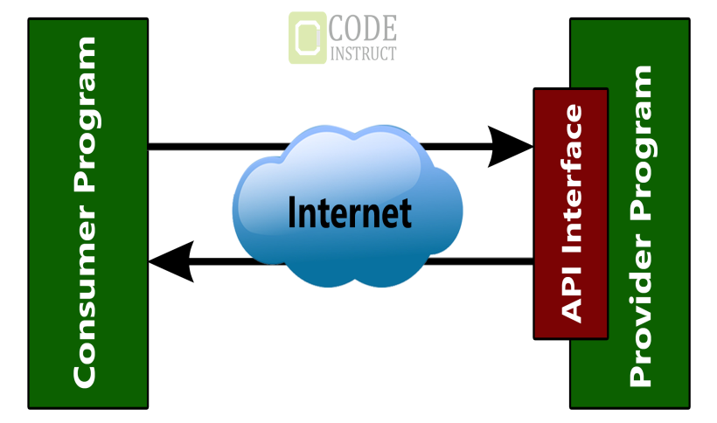
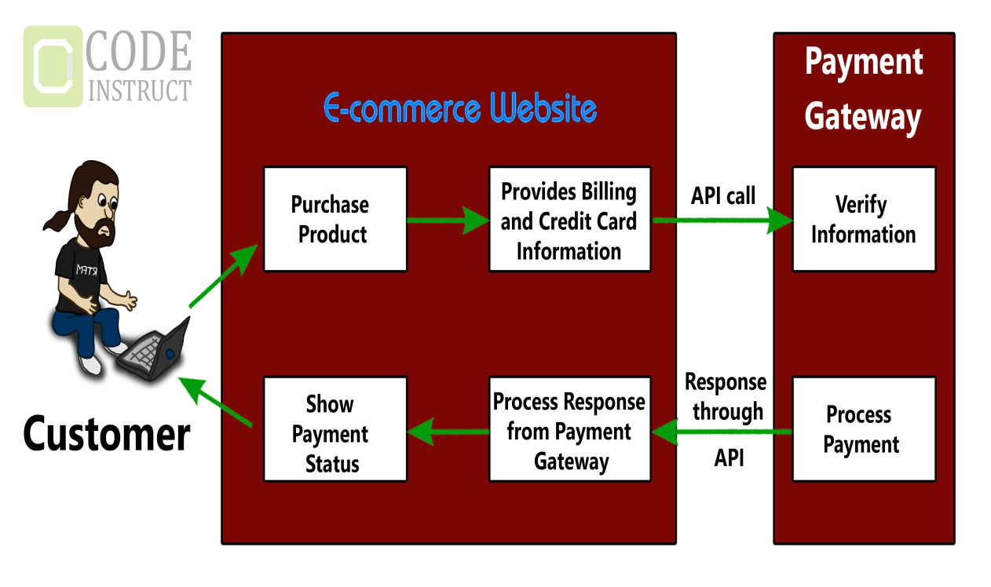
What is an API
Courtesy: Code Instruct

Slide 15
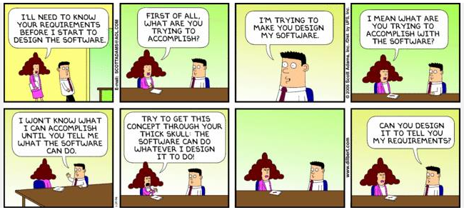
We cant do this… but..
It is only as of today

Slide 16
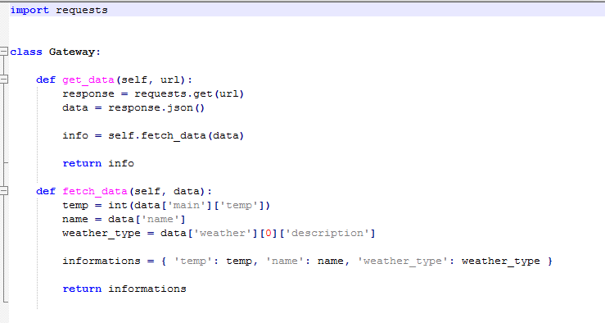
For today, Lets do a simple weather app
Tip: Metric unit can be returned by adding &unit=metric to the url
API Call using right appID returns:
http://api.openweathermap.org/data/2.5/weather?q=London,uk&appid=cemc5d4m4829241dc9b2ddbd3cc25a73
requests will get this
.json() will jsonify it
fetch_data will pass data to def:
Extract temperature value from subkey temp inside primary key “main” and convert it to integer
Source: https://github.com/Cosaquee/flask-weather-app?_sm_au_=i6Vtrf7TZq61T5wN

Slide 17
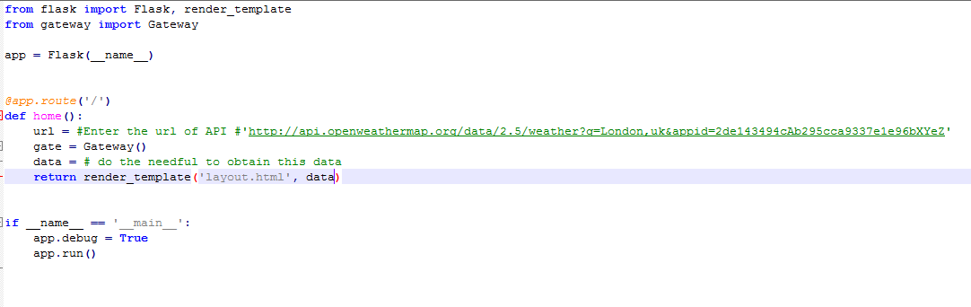
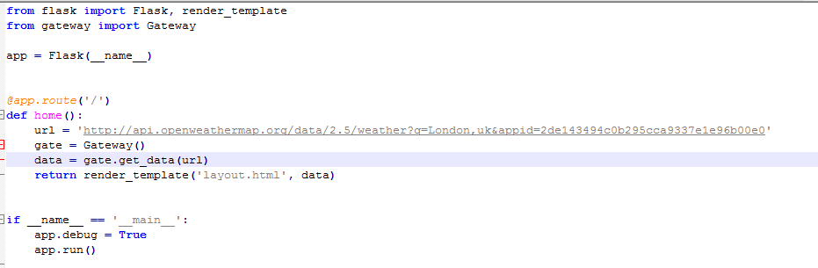
Modify main.py

Slide 18
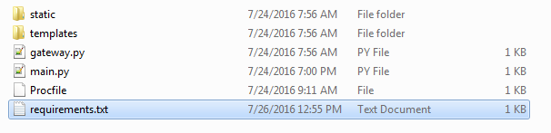
Clean the folder – Alternate is to use .cfignore
Procfile contains:
And does not contain any extension. This file can be created using git bash
Use vi Procfile
Tap ‘i’ for insert
Type in above text
Press Esc
Type ‘ZZ’ –
(To save and exit. ZZ wont appear in the file# Notice ZZ is in capital letters)
Use:
cf login followed by
cf push to deploy app

Slide 19
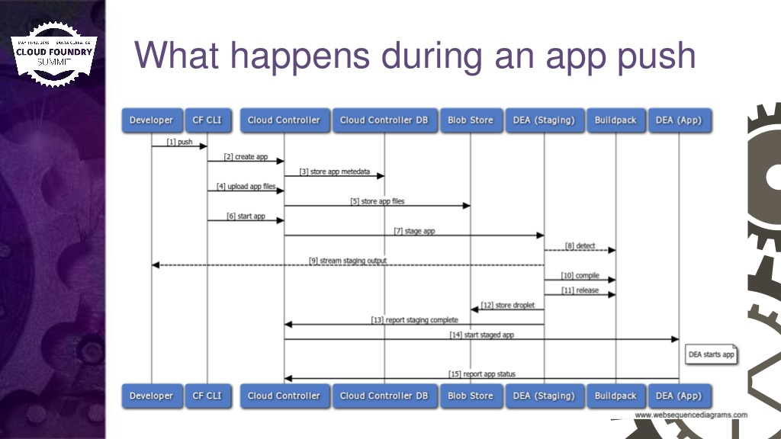
Source: http://www.slideshare.net/greensight/10-common-errors-when-pushing-apps-to-cloud-foundry

Slide 20
How do you think this App is useful for GE Power Customers

Slide 21
How can you contribute?
Design docs in excel can become an app for instance
Your transfer function from FEA simulation can become useful surrogate model in an app
Pour your ideas at:
asd
Anything and everything we do can be an app or part of an app…
Come up with ideas… more than welcome to make it an app…

Slide 23

GE Digital Solutions Example…

